Slide 1
Deep Learning
Generated for: RNNs, Deep Learning
Notes:
Welcome to the Deep Learning presentation covering multiple topics. Today we'll explore: RNNs, Deep Learning.

Slide 2
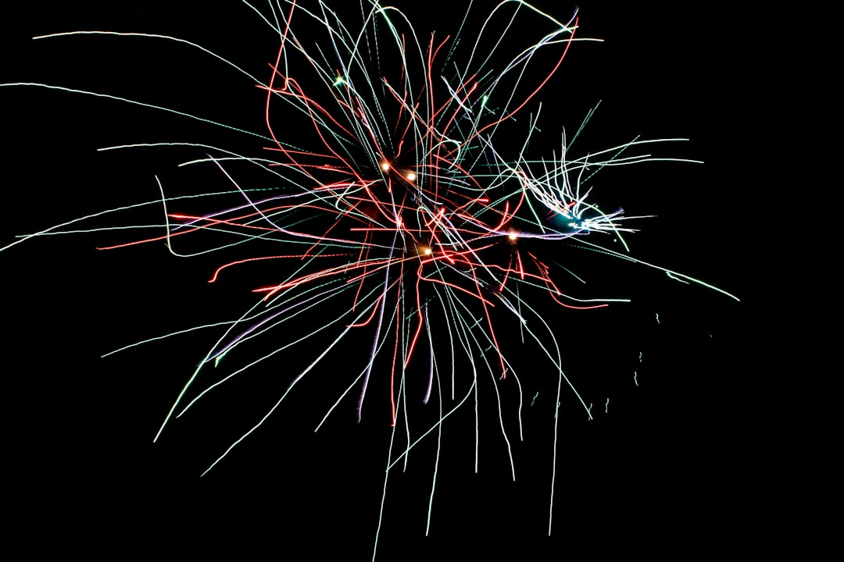
RNNs - Introduction
Recurrent Neural Networks process sequential data
RNNs have feedback connections for temporal relationships
Used for speech recognition and natural language processing
RNNs can learn from experience and adapt over time
Effective for predicting outcomes in sequential data
Training RNNs can be challenging due to vanishing gradients
RNNs are key components in many deep learning models
Applications include language translation and text summarization
RNNs can handle variable-length input sequences
Basic RNN architecture includes input, hidden, and output layers
Notes:
When introducing RNNs, explain that they are designed to handle sequential data, such as speech or text, and that they have feedback connections that allow them to capture temporal relationships. Provide examples of applications, such as speech recognition or language translation, and ask students to consider how RNNs can be used to improve these tasks. Discuss the challenges of training RNNs, including vanishing gradients, and introduce the basic RNN architecture, highlighting the input, hidden, and output layers. Key takeaways should include the importance of RNNs in deep learning and their ability to learn from experience and adapt over time.

Slide 3

RNNs - Introduction
Recurrent Neural Networks process sequential data
RNNs have feedback connections for temporal relationships
Useful for speech recognition, language modeling tasks
RNNs can learn from experience, adapt to changes
Simple RNNs have limitations, such as vanishing gradients
Long Short-Term Memory networks address these limitations
Gated Recurrent Units are another variant of RNNs
RNNs can be trained using backpropagation through time
RNNs require careful tuning of hyperparameters, learning rates
Notes:
When introducing RNNs, emphasize their ability to handle sequential data and temporal relationships. Provide examples of speech recognition and language modeling tasks. Explain the concept of feedback connections and how they enable RNNs to learn from experience. Discuss the limitations of simple RNNs, such as vanishing gradients, and introduce variants like LSTM and GRU. Mention the importance of hyperparameter tuning and learning rates in training RNNs. Ask students to consider how RNNs can be applied to real-world problems, such as predicting stock prices or generating text.

Slide 4
RNNs - Introduction
Recurrent Neural Networks process sequential data
RNNs have feedback connections for temporal relationships
Used for speech recognition and language modeling
Can learn patterns in time series data
Basic RNN architecture includes input, hidden, output
Hidden state captures information from previous steps
Output depends on hidden and current input states
Training RNNs involves backpropagation through time
RNNs can suffer from vanishing gradient problem
Simple RNN equation: h_t = sigmoid(W*x_t + U*h_(t-1))
Notes:
When introducing RNNs, emphasize their ability to handle sequential data and learn temporal relationships. Provide examples such as speech recognition, language translation, and time series forecasting. Explain the basic architecture and how the hidden state is used to capture information from previous steps. Discuss the challenges of training RNNs, including the vanishing gradient problem. Ask students to consider how RNNs can be applied to real-world problems and what advantages they offer over other neural network architectures. Key takeaways include understanding the role of feedback connections and the importance of the hidden state in RNNs.

Slide 5
Deep Learning - Introduction
Deep learning is a subset of machine learning methods
Inspired by the structure and function of the brain
Uses artificial neural networks to analyze data
Enables computers to learn from experience
Improves performance on complex tasks over time
Requires large amounts of data and computing power
Has many applications in computer vision and speech
Can be used for image recognition and natural language
Deep learning models are often trained on GPUs
Have many layers of neural networks to learn patterns
Notes:
When introducing deep learning, explain that it's a type of machine learning that's inspired by the brain's structure and function. Give examples of how deep learning is used in everyday applications such as image recognition, speech recognition, and natural language processing. Ask students if they have any experience with machine learning or neural networks. Emphasize the importance of large datasets and computing power in training deep learning models. Provide examples of how deep learning has improved performance on complex tasks over time, such as self-driving cars and language translation. Key takeaways include understanding the basics of deep learning, its applications, and the requirements for training deep learning models.

Slide 6
Deep Learning - Introduction
Deep learning is a subset of machine learning methods
Inspired by the structure and function of the brain
Uses artificial neural networks to analyze data
Can learn from large amounts of data automatically
Enables computers to perform complex tasks
Such as image recognition and natural language processing
Requires significant computational resources and data
Has many applications in computer vision and robotics
Used in self-driving cars and medical diagnosis systems
Improves performance as amount of data increases
Notes:
When introducing deep learning, explain that it's a type of machine learning that's inspired by the brain's structure. Provide examples of its applications, such as image recognition and natural language processing. Emphasize the need for large amounts of data and computational resources. Ask students to consider how deep learning is used in their everyday lives, such as in self-driving cars or medical diagnosis systems. Key takeaways include the ability of deep learning to learn from large datasets and improve performance over time.

Slide 7
Deep Learning - Introduction
Deep learning is a subset of machine learning methods
Inspired by structure and function of human brain
Uses artificial neural networks with multiple layers
Can learn complex patterns in large datasets
Applications in image recognition and speech processing
Requires significant computational resources and data
Key concept: backpropagation for training networks
Enable autonomous vehicles and medical diagnosis
Improves natural language processing capabilities
Enhances decision-making in various industries
Notes:
When introducing deep learning, emphasize its connection to machine learning and the human brain's structure. Explain that deep learning uses neural networks with multiple layers to learn complex patterns. Provide examples of applications such as image recognition and speech processing. Discuss the requirements for computational resources and data. Mention key concepts like backpropagation and its role in training networks. Use examples like autonomous vehicles and medical diagnosis to illustrate the impact of deep learning. Ask students about potential applications in their fields of interest and how deep learning can improve decision-making. Key takeaways should include understanding the basics of deep learning, its applications, and the importance of computational resources.

